Slide 1

Sit-Stand Desks
Work smart, stay healthy | Simplify your workstation

Slide 2
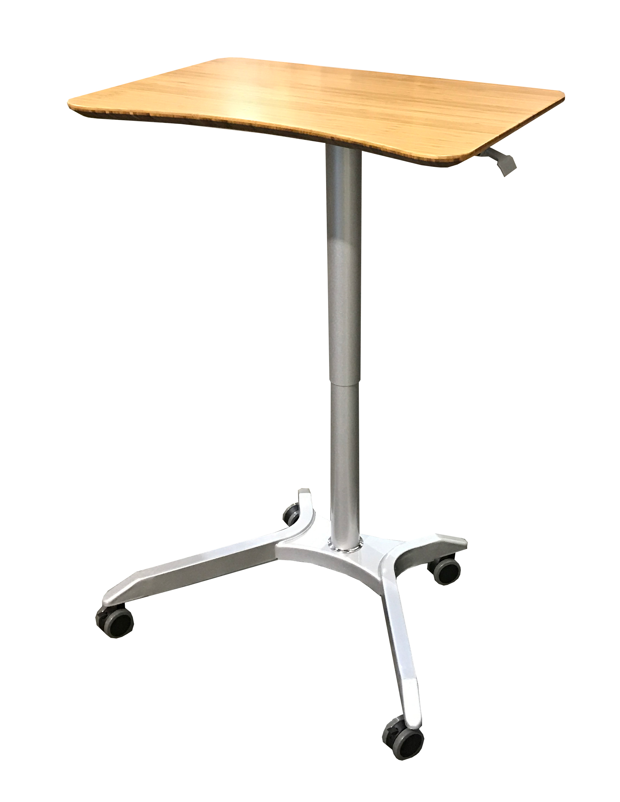
Why Choose an Adjustable Desk?
Adjustable desks have recently gained much popularity with research showing that sitting for extended periods of time can be detrimental to our health. The American Medical Association (AMA) agrees that sitting for extended periods of time can be bad for personal health. Their policy recommends organizations offer sitting alternatives, including standing desks.
What health problems have too much sitting been linked to?
- Worse mental health
- Higher risk of death from heart disease
- Higher risk of being disabled
- Heart attack
- High blood pressure
- Obesity
- Bad cholesterol
- Cancer
- Depression
- Negative impact on metabolic system

Slide 3
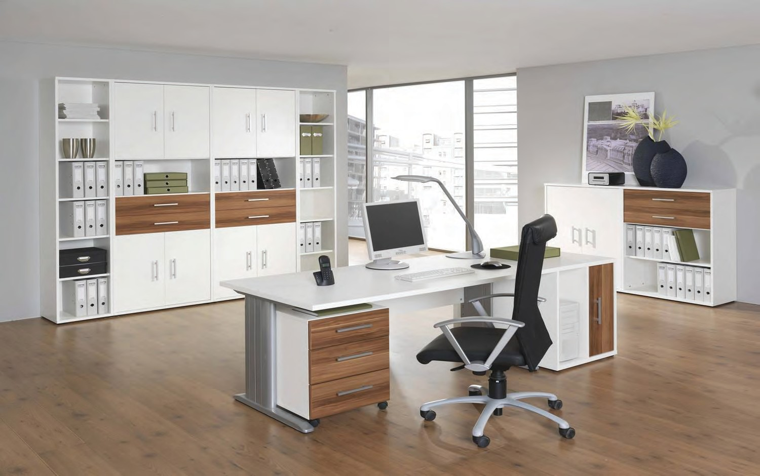
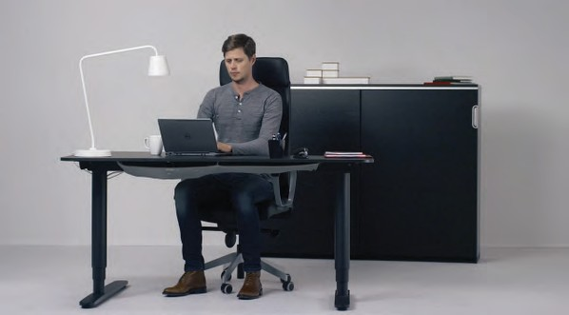
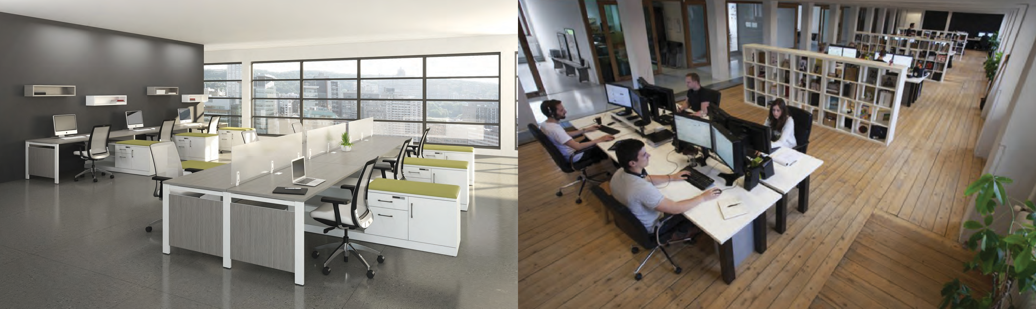
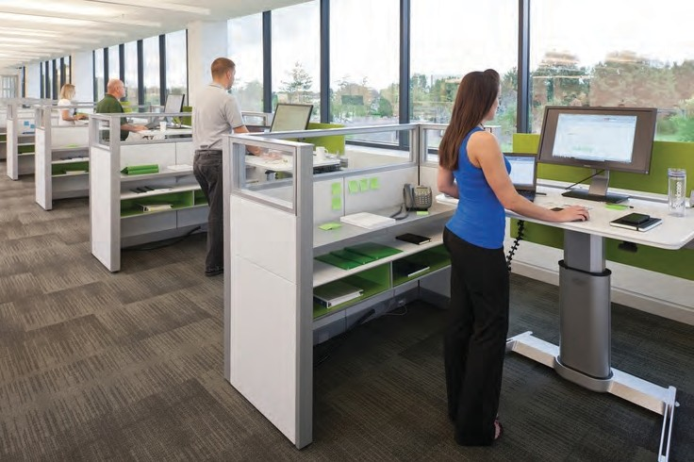
Sit/Stand Environments
Home Office
Work Office

Slide 4

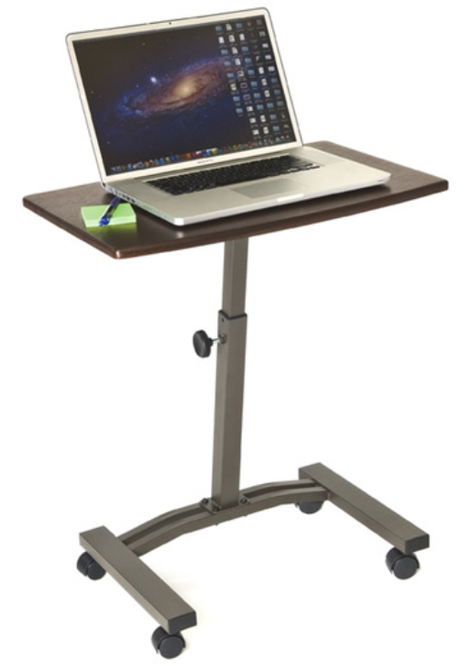


Model: WEB162
MSRP $49.99
TURNLIFT™ Classic Laptop Mobile Desk Cart
Features
Lift and lower the desk manually by turning a knob
Generous working surface suitable for use as a laptop desk, art station or a TV/reading table
Scratch-resistant woodgrain desk top
A wide, rectangular, metal base provides excellent stability while in motion and at rest
Low-profile base for easy use near furniture like couches
Assembly is easy with only a few parts; no drilling required.
Four 1.5-inch casters (2 locking) allow your work to travel with you anywhere in the office or at home
Specifications
Top Material: MDF with PVC finish
Top Area: 23.6" W x 15.74" D
Adjustment Type: Manual
Adjustment Range: 20.47" to 33" H
Overall Size: 23.6" W x 15.74" D x (20.47" to 33") H
Weight Capacity: 15 lbs
Walnut

Slide 5
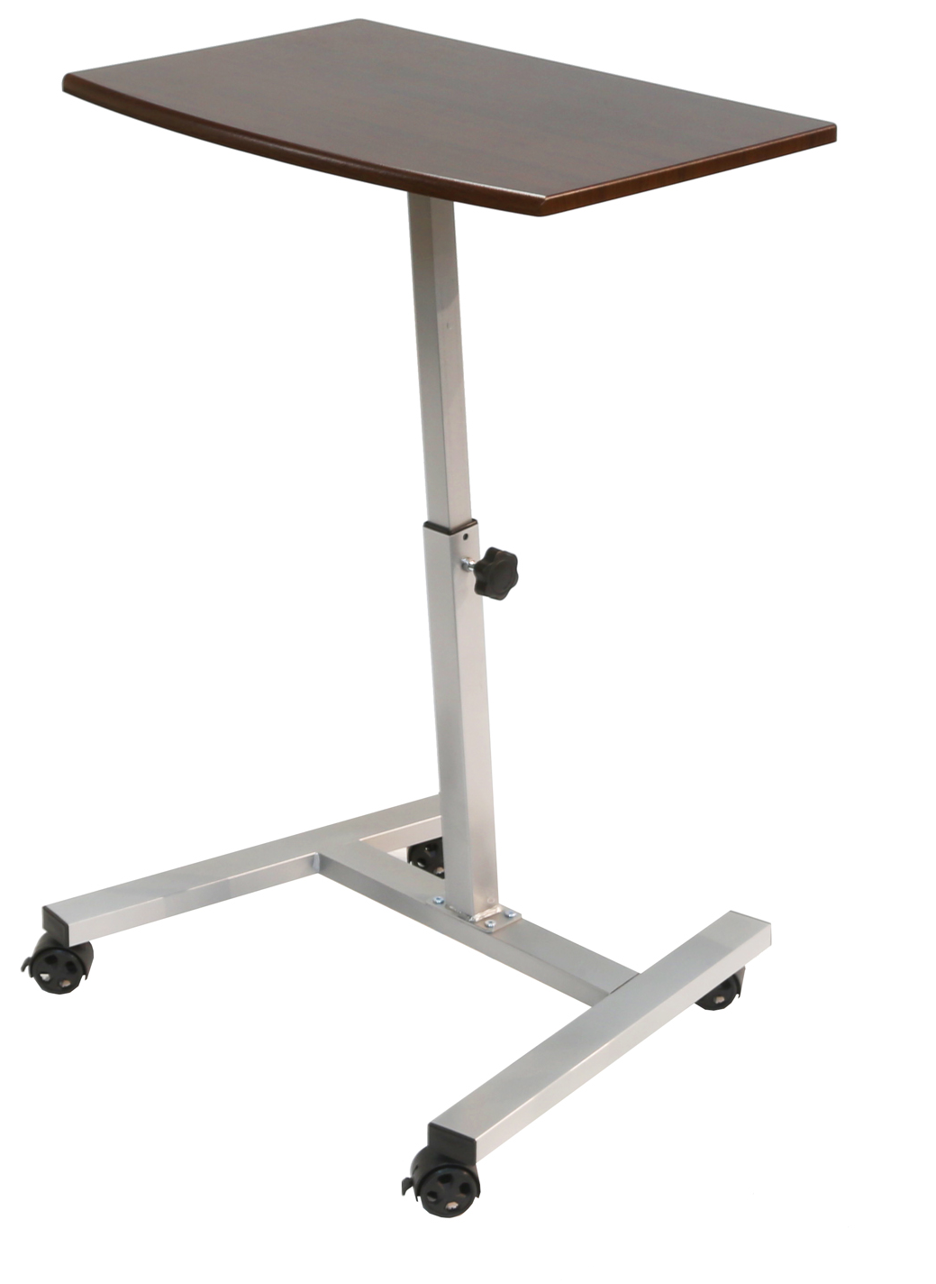
Model: WEB390
MSRP $54.99
TURNLIFT™ Laptop Mobile Desk Cart XL
Features
Lift and lower the desk manually by turning a knob
Largest desk top available on TURNLIFT™ models
Scratch-resistant woodgrain desk top
A wide, rectangular, metal base provides excellent stability while in motion and at rest
Low-profile base for easy use near furniture like couches
Assembly is easy with only a few parts; no drilling required.
Four 2-inch casters (2 locking) allow your work to travel with you anywhere in the office or at home
Specifications
Top Material: MDF with PVC finish
Top Area: 23.62" W x 17.32" D
Adjustment Type: Manual
Adjustment Range: 23.62" to 36.41" H
Overall Size: 23.62" W x 17.32" D x (23.62" to 36.41") H
Weight Capacity: 30 lbs
Walnut

Slide 6
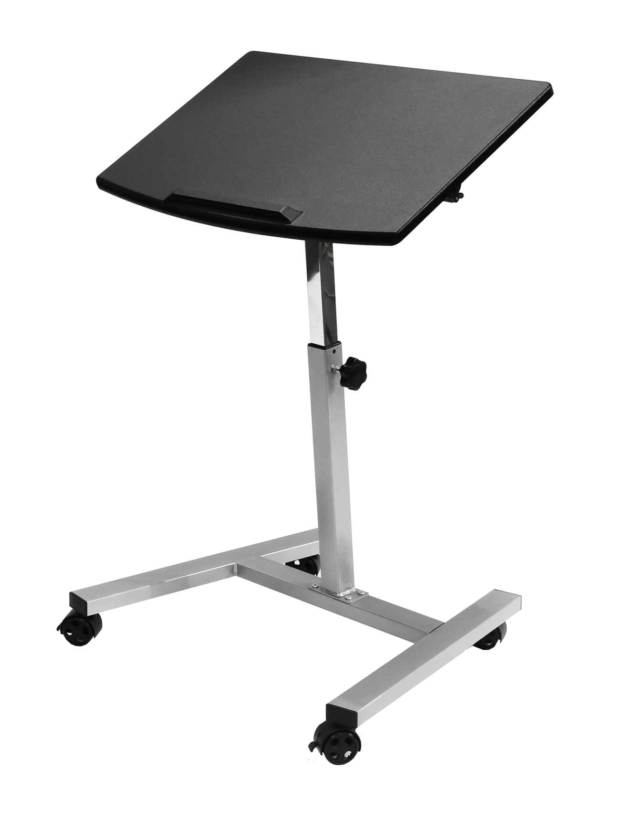

Model: WEB361
MSRP: $59.99
TURNLIFT™ Tilting Sit-Stand Desk Cart
Features
Tilt the angle of the tabletop for a more natural working position while typing, writing or drawing
Ledge prevents work from sliding off the table when tilted
Lift and lower the desk manually by turning a knob
Scratch-resistant desk top
Low-profile base for easy use near furniture like couches
Wide, steel base ensures wobble-free use
Four 2-inch casters (2 locking) allow your work to travel with you anywhere in the office or at home.
Specifications
Top Material: MDF with PVC finish
Top Area: 23.62“ W x 17.32“ D
Adjustment Type: Manual
Adjustment Range: 23.62" to 36.41" H
Overall Size: 23.62“ W x 17.32“ D x (23.62" to 36.41") H
Weight Capacity: 15 lbs
Black

Slide 7
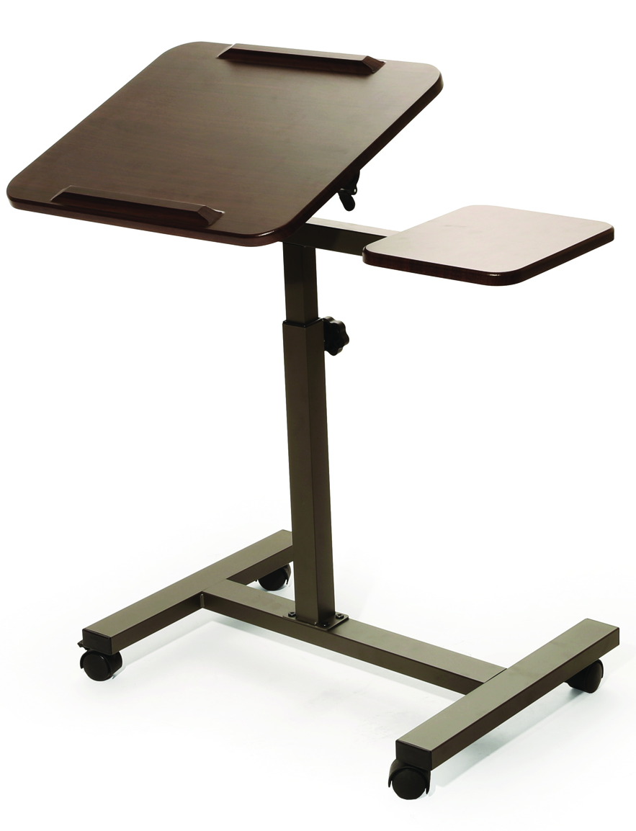
Model: WEB234
MSRP: $59.99
TURNLIFT™ Sit-Stand Desk Cart with Side Table
Features
Side table mounts to either side of the desk
Tilt the angle of the tabletop for a more natural working position while typing, writing or drawing
Ledge prevents work from sliding off the table when tilted.
Lift and lower the desk manually by turning a knob
Scratch-resistant woodgrain desk top
Low-profile base for easy use near furniture like couches
Wide, steel base ensures wobble-free use
Four 1.5-inch casters (2 locking) allow your work to travel with you anywhere in the office or at home
Specifications
Top Material: MDF with PVC finish
Main Table Area: 17.75" W x 15.75" D
Side Table Area: 8.3" W x 9.8" D
Adjustment Type: Manual
Adjustment Range: 27.9" to 40.7" H
Overall Size: 27.9" W x 15.9" D x (27.9" to 40.7") H
Weight Capacity: 20 lbs
Walnut

Slide 8
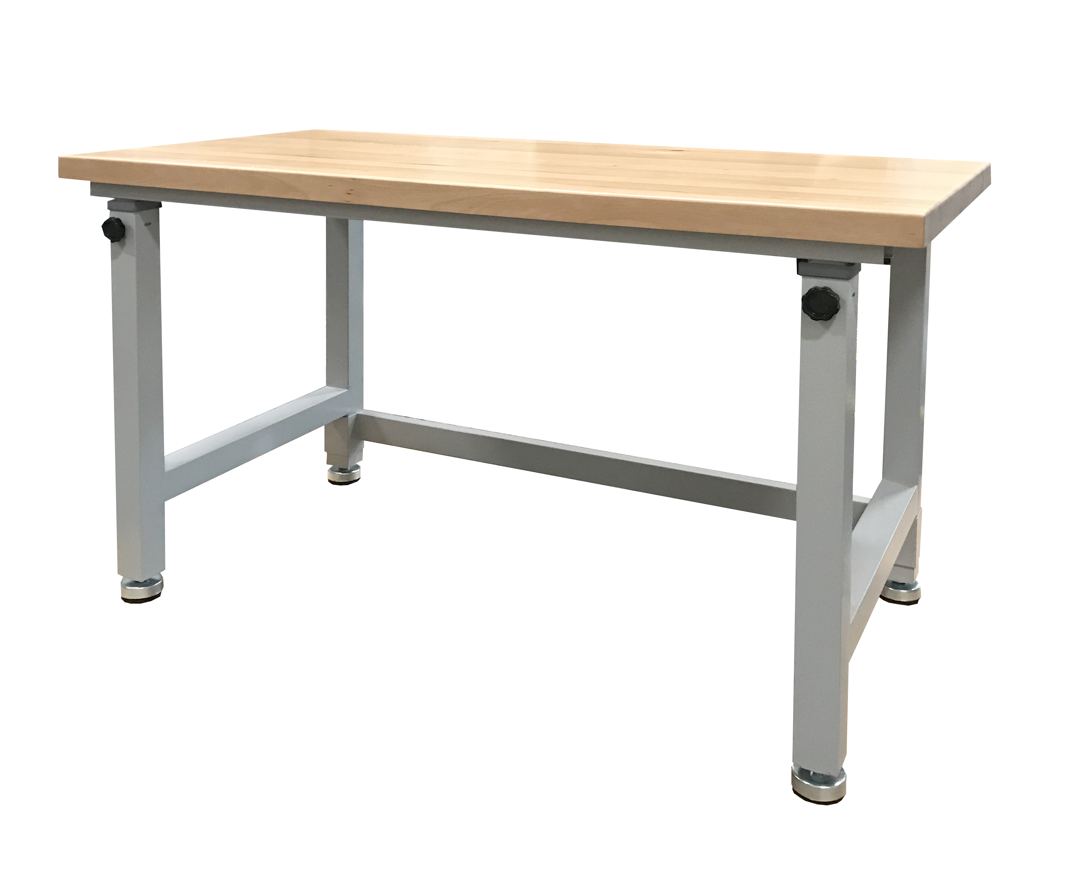
Model: 20288
TURNLIFT™ Height Adjustable Workbench
Specifications
Table height locks into place with turning knobs
Multilayered wood desk top
Damage-resistant polyurethane coated top
Powder-coated pewter frame
Top Material: Beech with Polyurethane finish
Top Area: 48" W x 24“ D
Adjustment Type: Manual
Adjustment Range: 28" to 42" H
Overall Size: 48" W x 24" D x (28" to 42") H
Weight Capacity: 500 lbs
Sit or Stand Tall – Table lifts to a full 42” for work (or play) while standing and can be lowered to a height of 28”.
Beech Wood– Tabletop constructed with beautiful golden beech and measures 1.5-inches thick.
Leveling Feet – Commercial-grade leveling feet work automatically to ensure your workspace stays secure no matter what.
Heavy Duty – Designed for real work, the desk top is protected with several layers of sealer and polyurethane. Don’t worry about the wood.

Slide 9

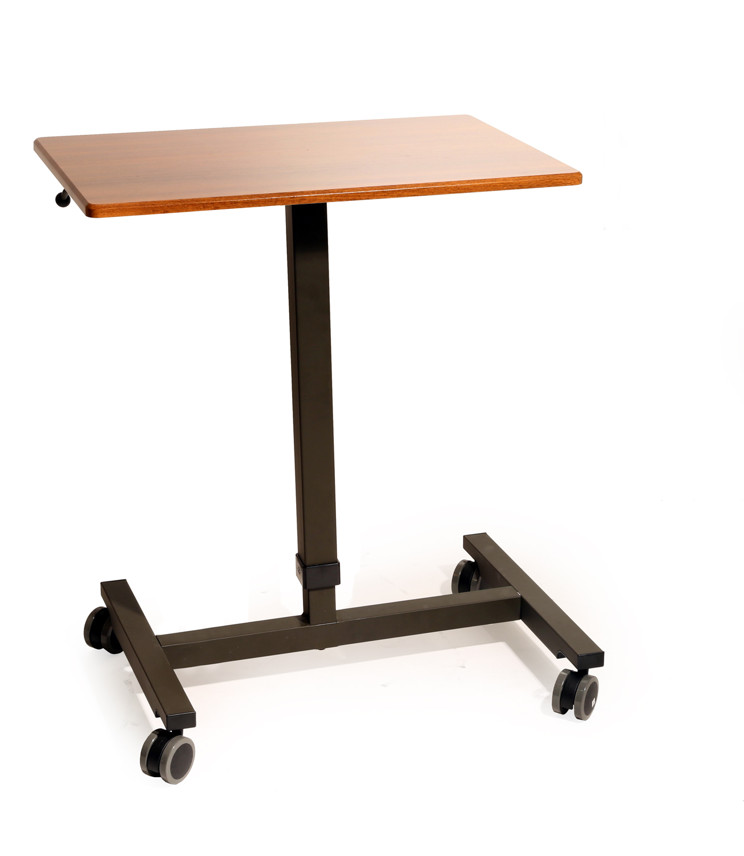

Model: OFF42630
MSRP: $119.99
AIRLIFT™ Classic Laptop Mobile Desk Cart
Features
Effortless pneumatic height adjustment
Timeless design fits almost any environment
Scratch-resistant woodgrain desk top
Powder-coated steel frame
Low-profile base allows easy use near other furniture
Four 2.36-inch casters (2 locking) allow your work to travel with you anywhere in the office or at home
Specifications
Top Material: MDF with PVC finish
Top Area: 24.4“ W x 15.7" D
Adjustment Type: Pneumatic
Adjustment Range: 29.3" to 41.7" H
Overall Size: 24.4" W x 15.7" D x (29.3" to 41.7") H
Weight Capacity: 35 lbs.
Maple

Slide 10
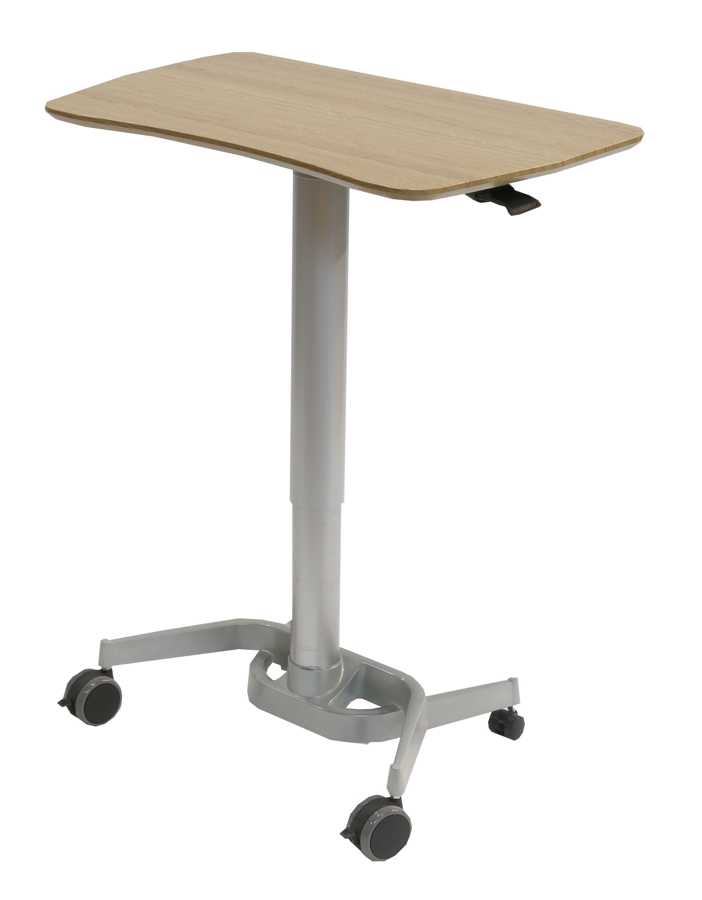

Model: OFF16017
MSRP: $249.99
AIRLIFT™ Sit-Stand Mobile Desk
Features
Effortless pneumatic height adjustment
Large desk top surface area
Scratch-resistant woodgrain desk top
Lightweight aluminum frame and base
Four locking (3-inch and 1.5-inch) casters allow your work to travel with you anywhere in the office or at home
Specifications
Top Material: MDF with PVC finish and melamine bottom
Top Area: 28" W x 18" D
Adjustment Type: Pneumatic
Adjustment Range: 27.75" to 41.5" H
Overall Size: 28" W x 18" D x (27.75" to 41.5") H
Weight Capacity: 35 lbs
Birch

Slide 11
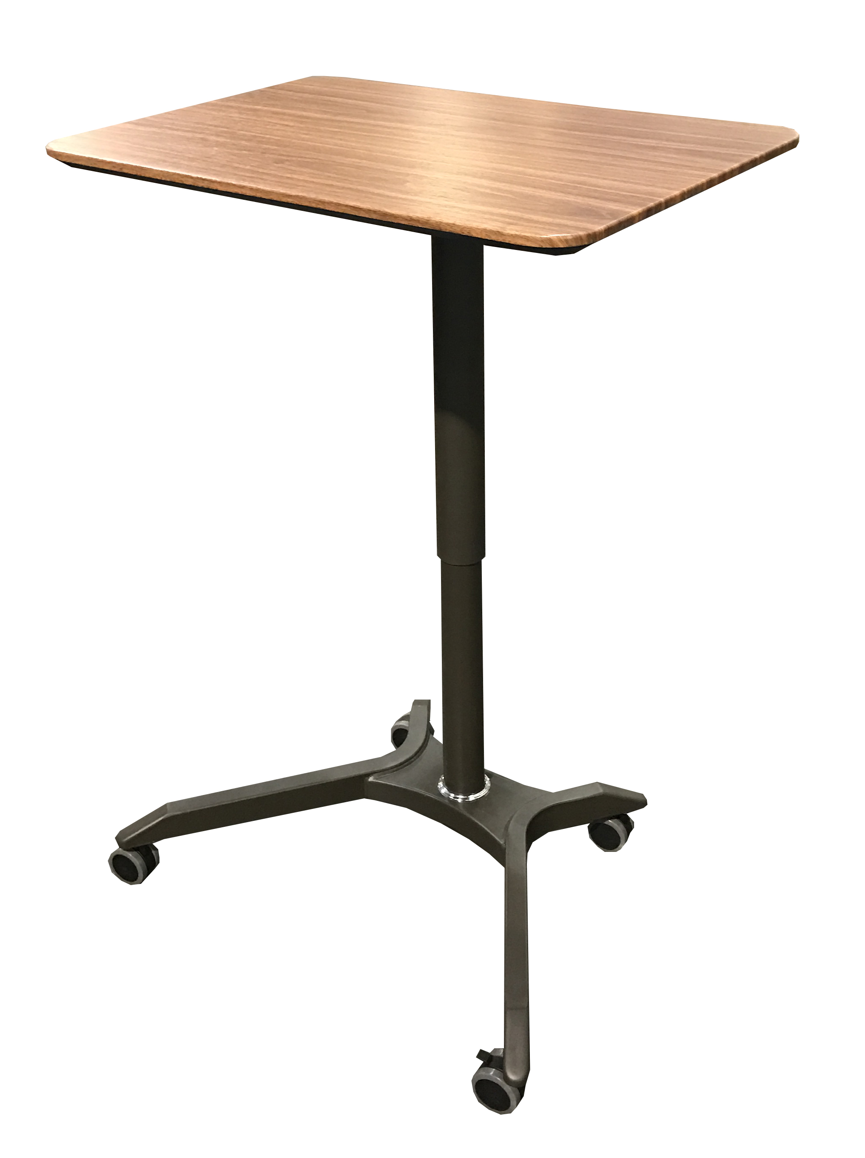
Model: OFF42633
MSRP: $249.99
AIRLIFT™ XL Sit-Stand Mobile Desk
Features
Largest single-column AIRLIFT™ desk
Effortless pneumatic height adjustment
Powder-coated steel frame
Scratch-resistant desk top available in different finishes
Solid bamboo desk top also available
Wide base provides wobble-free use
Four 2.36-inch casters (2 locking) make it easy to take your work with you
Specifications
Top Material: MDF with PVC finish
Top Area: 28.1“ W x 19.6“ D
Frame Color: Dark Brown
Adjustment Type: Pneumatic
Adjustment Range: 27.1" to 41.9" H
Overall Size: 28.1" W x 19.6" D x (27.1" to 41.9") H
Weight Capacity: 35 lbs
Maple

Slide 12
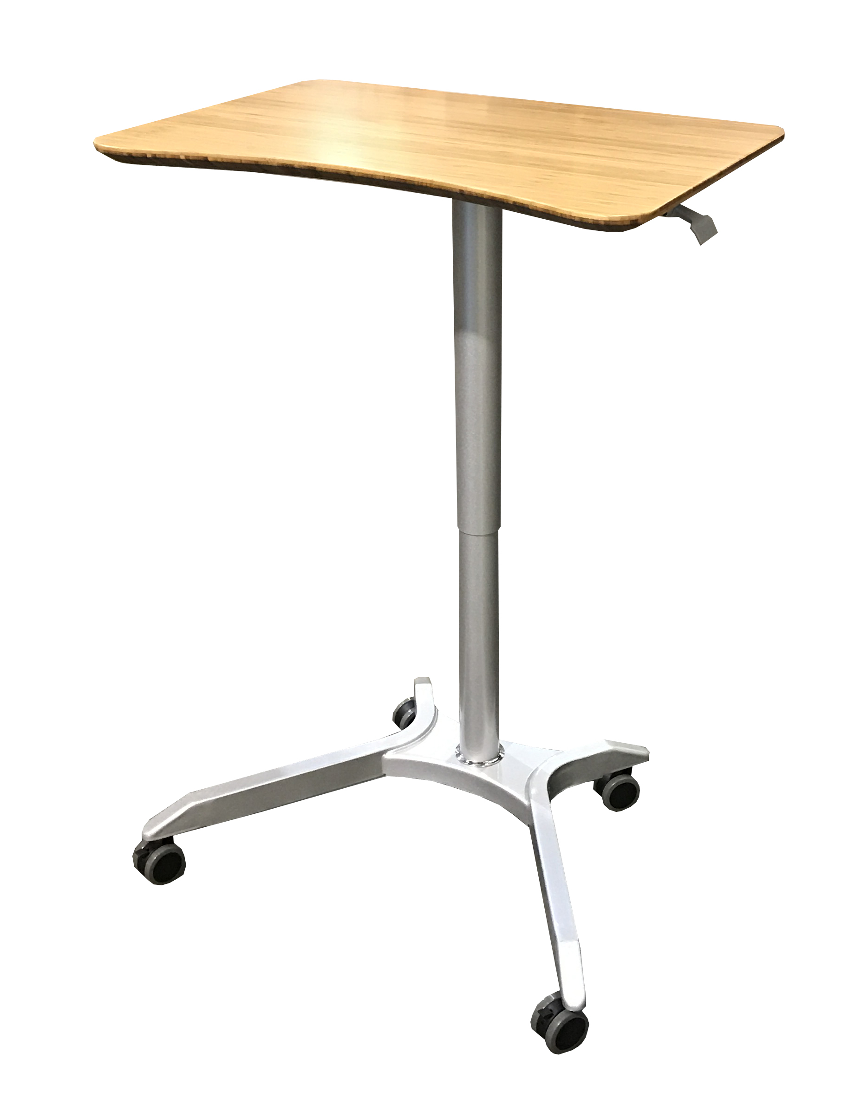

Model: TBD
MSRP: $299.99
AIRLIFT™ XL Sit-Stand Mobile Desk Bamboo
Features
Largest single-column AIRLIFT™ desk
Gorgeous layered bamboo top
Ergonomically curved desktop allows users to sit closer
Effortless pneumatic height adjustment
Powder-coated steel frame
Wide base provides wobble-free use
Four 2.36-inch casters (2 locking) make it easy to take your work with you
Specifications
Top Material: Bamboo
Top Area: 28.1" W x 19.6“ D
Frame Color: Platinum
Adjustment Type: Pneumatic
Adjustment Range: 27.1" to 41.9" H
Overall Size: 28.1" W x 19.6" D x (27.1" to 41.9") H
Weight Capacity: 35 lbs
Bamboo

Slide 13
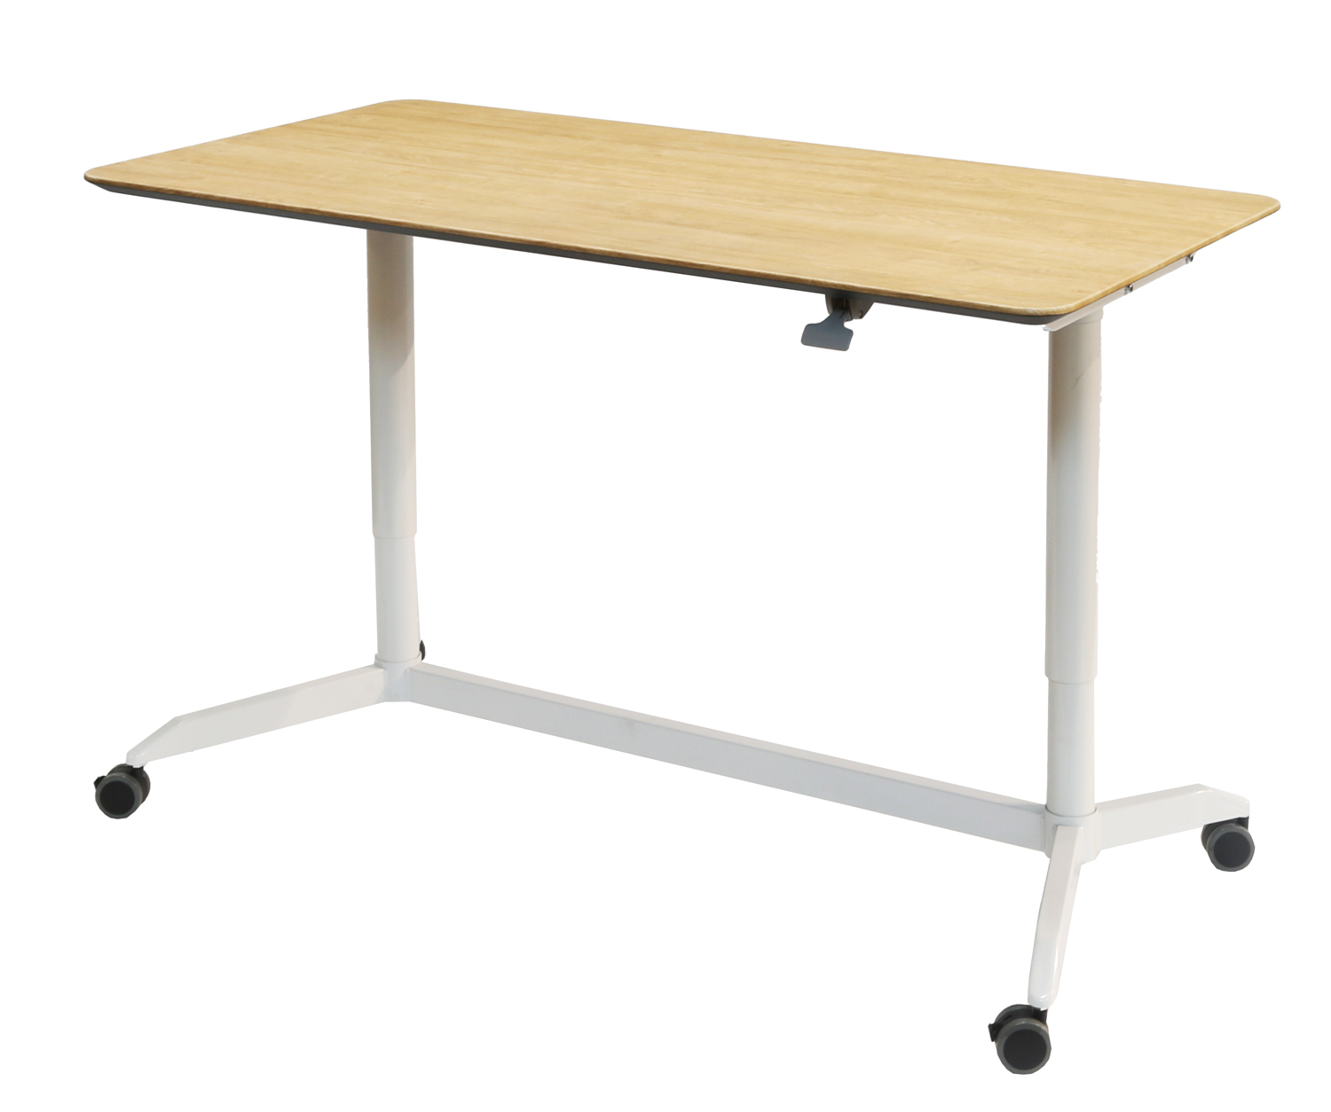
Model: OFF16020
MSRP: $399.99
AIRLIFT™ Dual Sit-Stand Desk
Birch
Intuitive Adjustment – Table changes height using a pressurized cylinder, like on an office chair. Lift up on the paddle and the table rises automatically.
Chamfered Edges – The table features a slanted edge which makes getting close without bumping a knee easy.
Mobile Desk – Four casters (2 locking) allow your work to travel with you anywhere in the office or at home.
Specifications
Two post pneumatic height adjustment
Single-paddle height adjuster
Rectangular desk top with chamfered edges
Four 2.36-inch casters (2 locking) make it easy to take your work with you
Top Material: MDF with PVC finish
Top Area: 55.1" W x 26.7" D
Adjustment Type: Pneumatic
Adjustment Range: 28.3" to 42.9" H
Overall Size: 55.1" W x 26.7" D x (28.3" to 42.9") H
Weight Capacity: 70 lbs

Slide 14

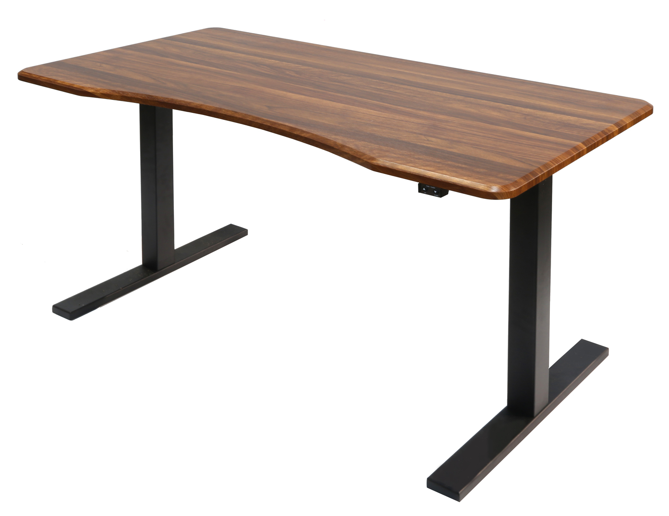
Model: OFF16018 MSRP: $599.99
Airlift™ Classic Electric Sit-Stand Desk
Walnut
Simple Operation – One electric motor and two buttons for height adjustment. Easy.
Electric Motor – Precise height adjustment is effortless thanks to an electric motor. No human effort required aside from a button press.
Ergonomic Desk – Curved desk top allows users to be closer to the table while working. The curve features a beveled edge that acts as a built-in wrist wrest. Less strain, less pain.
Scratch-Resistant – Top finished in hard PVC for protection from abrasive dangers and the hazards of daily life.
Specifications
Digital two-button controller for height adjustment
Two section telescoping frame
Steel feet and frame
Ergonomic desk top with beveled edges
Scratch-resistant desk top
Top Material: MDF with PVC finish
Top Area: 60" W x 30“ D
Adjustment Type: Dual electric motors
Adjustment Range: 29.3" to 48.6" H
Adjustment Rate: 1.02" per second
Overall Size: 60" W x 30“ D x (29.3" to 48.6") H
Weight Capacity: 165 lbs

Slide 15
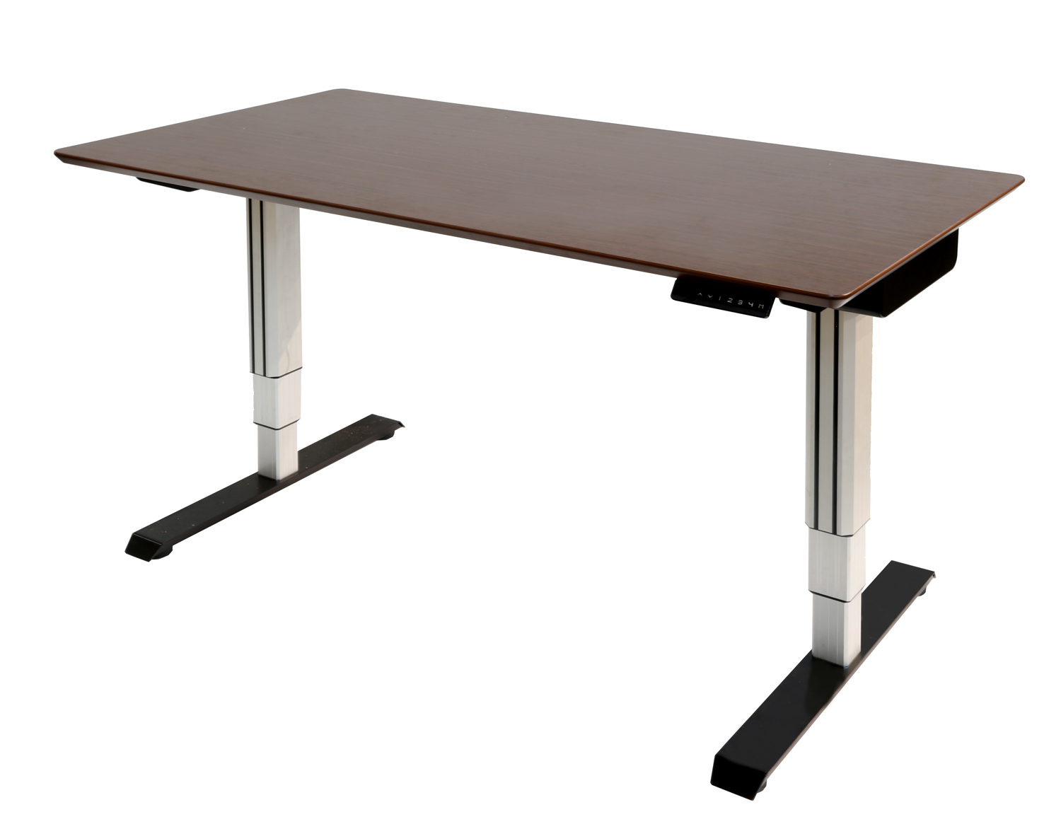
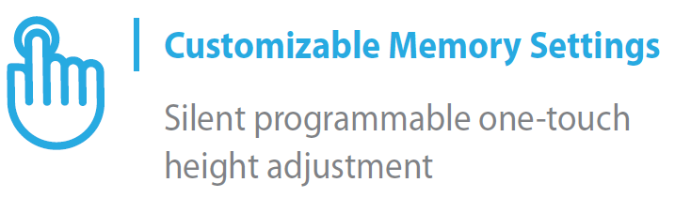

Model: OFF42636
MSRP: $799.99
Espresso
PROLIFT™ Dual Electric Sit-Stand Desk
Specifications
Digital touchpad controller for height adjustment
Memory settings for up to 4 heights
Motors operate under 55 dB when in use
Three section telescoping frame
Aluminum frame with steel base
Scratch-resistant desk top
Rectangular desk top with chamfered edges
Top Material: MDF with melamine finish
Top Area: 60" x 30"
Adjustment Type: Dual electric motors
Adjustment Range: 24.8" to 51.2" H
Adjustment Rate: 1.37" per second
Overall Size: 60" x 30" x (24.8" to 51.2") H
Frame Extend Range: 47.2" to 70.9" W
Weight Capacity: 176 lbs
Multi-User Ready – Adjust the height using buttons on the digital controller and save up to four positions. That’s useful for households and workspaces with multiple users.
Extendable Frame – Upgrade to a larger desk top when you’re ready. The frame comes extends to fit desks as large as 60 inches wide.
More Range – Enjoy more height adjustability than AIRLIFT™ and TURNLIFT™ desks at their lowest and highest settings.
Scratch-Resistant – Top finished in super-hard melamine for protection from abrasive dangers and the hazards of daily life.
Sustainable Materials – Frame is built with aluminum legs and steel feet.

Slide 16
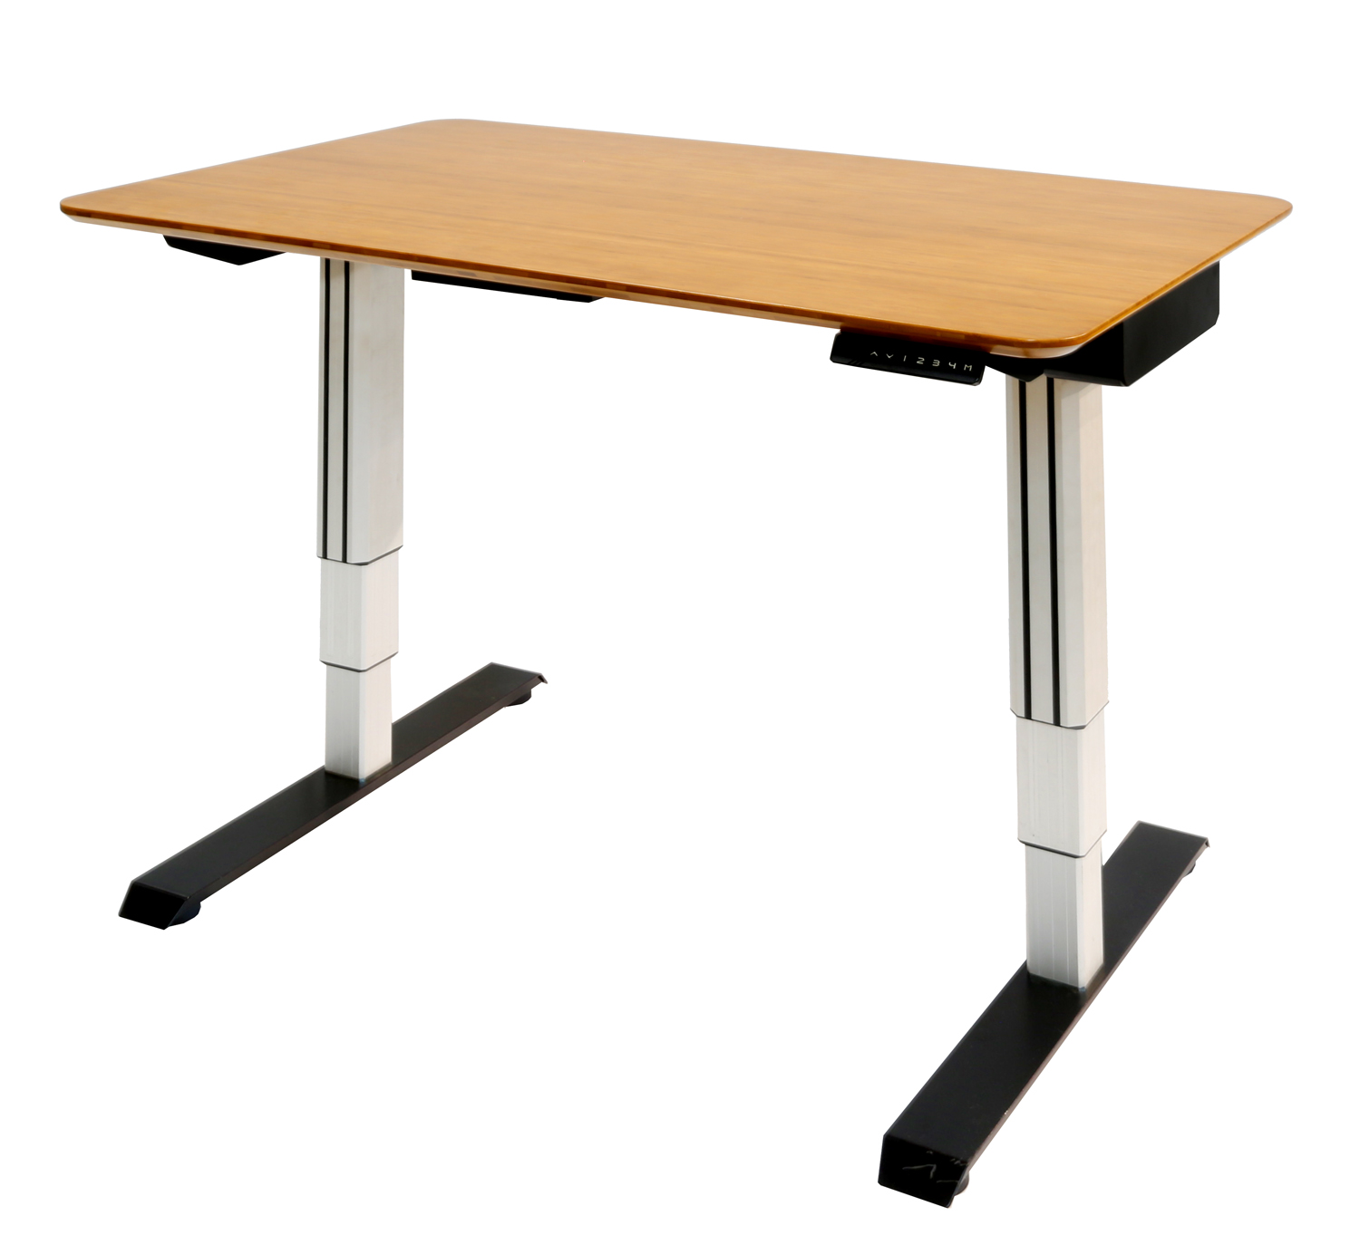
Model: OFF42632
MSRP: $849.99
Bamboo
Specifications
Digital touchpad controller for height adjustment
Memory settings for up to 4 heights
Motors operate under 55 dB when in use
Three section telescoping frame
Aluminum frame and steel base
Scratch-resistant surface
Rectangular desk top with chamfered edges
Top Material: Bamboo*
Top Area: 48“ W x 30“ D
Adjustment Type: Dual electric motors
Adjustment Range: 24.8" to 51.2" H
Adjustment Rate: 1.37" per second
Overall Size: 48" W x 30" D x (24.8" to 51.2") H
Frame Extend. Range: 47.2" to 70.9" W
Weight Capacity: 176 lbs
PROLIFT™ Dual Electric Sit-Stand Desk
Programmable – Adjust the height using buttons on the digital controller and save up to four. That’s useful for households and workspaces with multiple users.
Extendable Frame – Upgrade to a larger desk top when you’re ready. The frame comes extends to fit desks as large as 60 inches wide.
Sustainable Materials – Both the frame and base are built of recyclable materials. This desk is also available with a multi-layered bamboo top.
More Range – Enjoy more height adjustability than AIRLIFT™ and TURNLIFT™ desks at their lowest and highest settings.
*Also available with MDF and melamine top

Slide 17
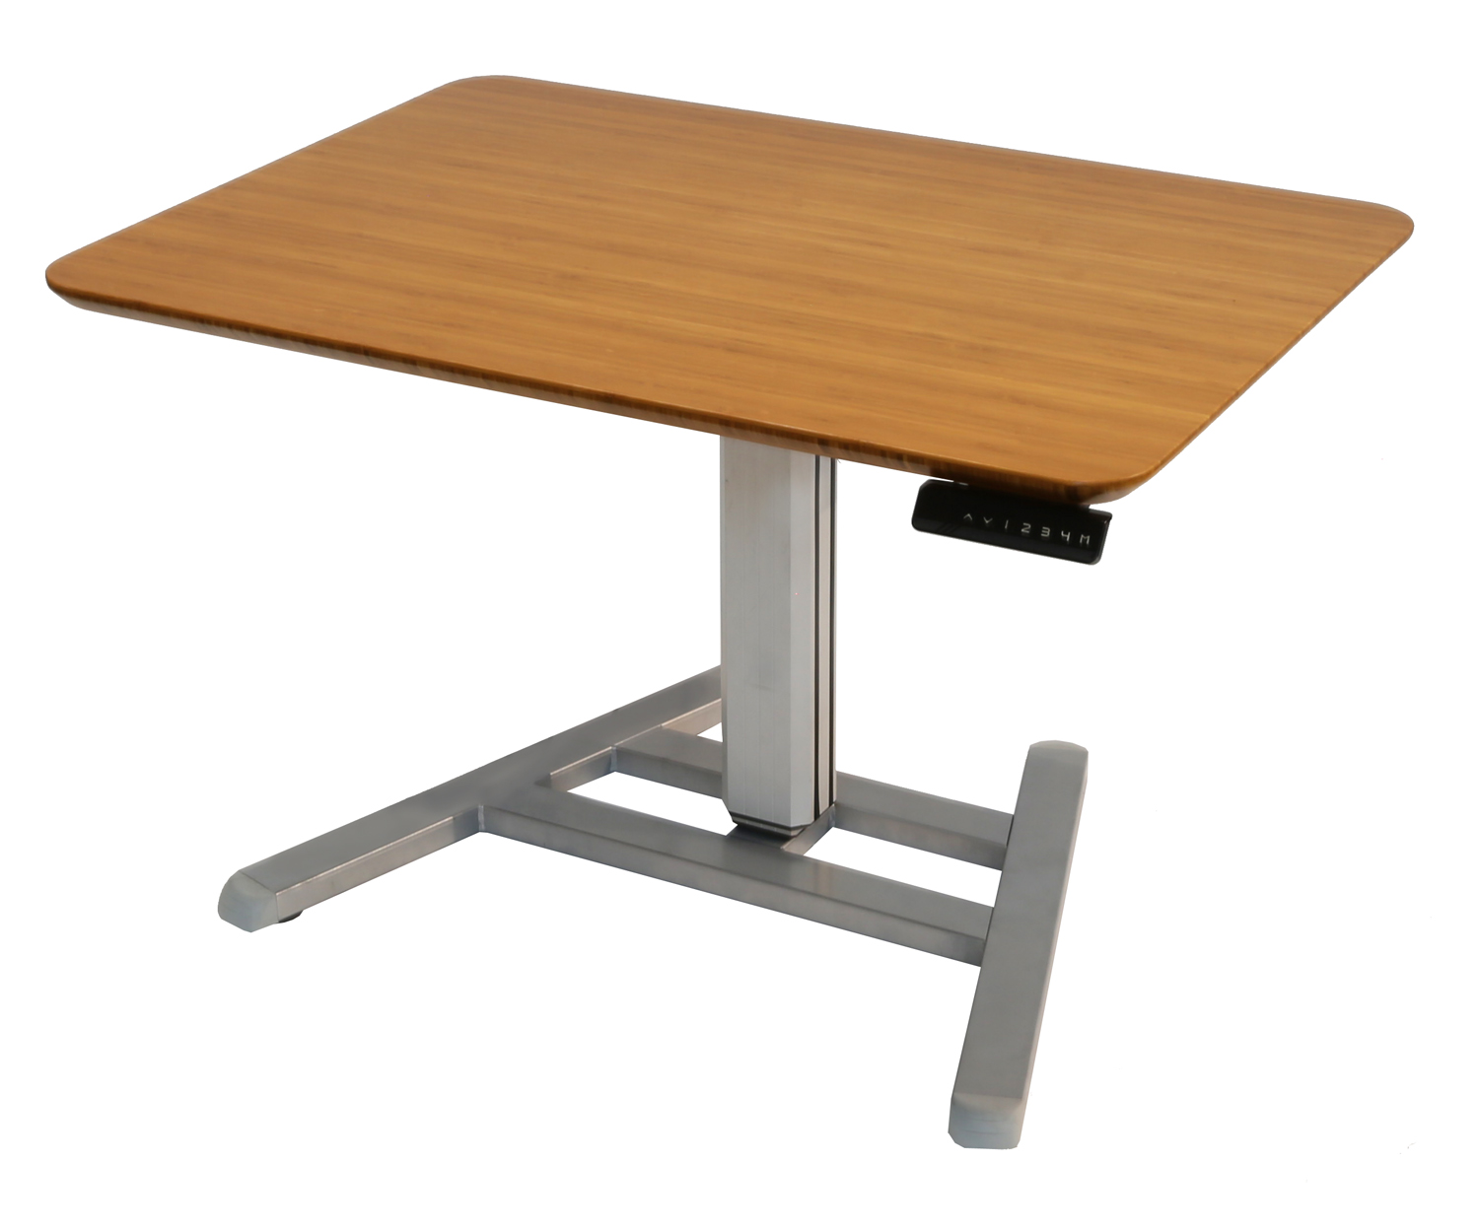
Model: OFF42634 MSRP: $649.99
Bamboo
Specifications
Digital touchpad controller for height adjustment
Memory settings for up to 4 heights
Motors operate under 55 dB when in use
Aluminum frame and steel base
Scratch-resistant desk top standard
Rectangular desk top with chamfered edges
Top Material: Bamboo*
Top Area: 39.4" W x 28" D
Adjustment Type: Single electric motor
Adjustment Rate: 1.37" per second
Adjustment Range: 24.8" to 51.2" H
Overall Size: 39.4" W x 28" D x (24.8" to 51.2") H
Weight Capacity: 88 lbs
PROLIFT™ Electric Sit-Stand Workstation
Personal Space – Measuring only 40” by 28,” this is the most compact standalone electric desk offered by Seville Classics.
Enhanced Range – Enjoy more height adjustability than AIRLIFT™ and TURNLIFT™ desks at their lowest and highest settings.
Programmable – Adjust the height using buttons on the digital controller and save up to four. That’s useful for households and workspaces with multiple users.
Sustainable Materials – Both the frame and base are built of recyclable materials. This desk is also available with a multi-layered bamboo top.
*Also available with MDF and melamine top

Slide 18
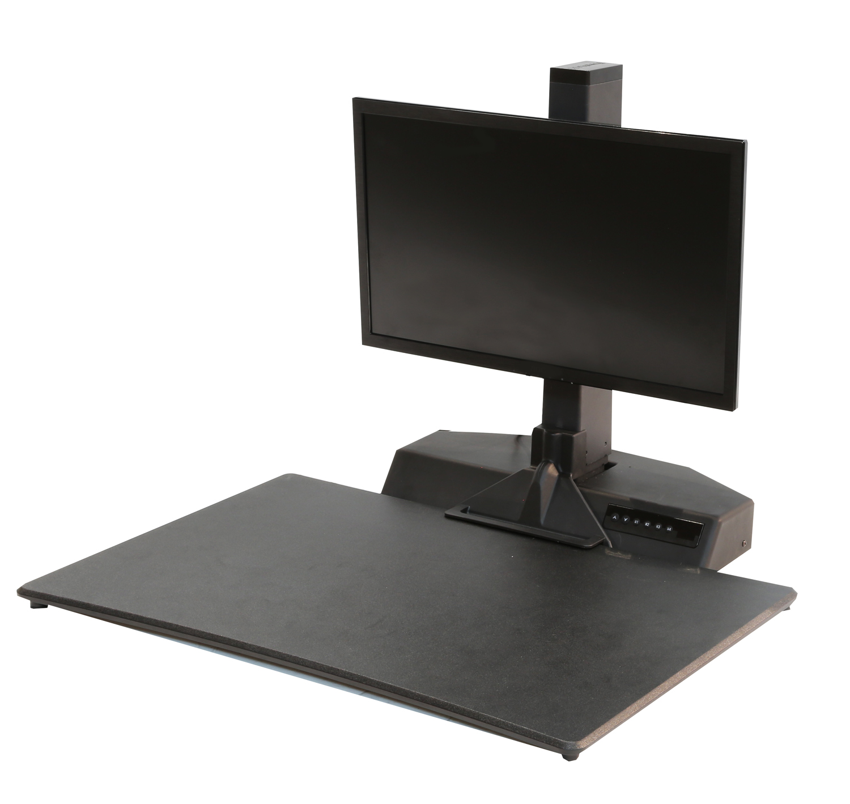
Model: OFF16016
MSRP: $499.99
PROLIFT™ Electric Desk-on-Desk
Specifications
Electronically motorized height adjustable desk top
Digital button-press controller with memory settings for up to 4 heights
Manually adjustable monitor height using a turn-knob
Supports monitor sizes up to 27”
Two section telescoping frame
Solid steel construction
Comes with remote control
Top Material: Plastic
Top Area: 31.5" W x 20.87" D
Adjustment Type: Single electric motor
Adjustment Rate: .78" per second
Adjustment Range: 2.76" to 19.68" H
Overall Size: 31.5" W x 20.87" D x 19.68" H
Weight Capacity: 33 lbs
Ergonomic Workspace – Desk features a stylish beveled edge for a more comfortable surface when typing.
Tabletop Sit-Stand Converter – Instantly turn any table into a sit-stand desk. Simply place it on a table, plug it in, and add some activity to your routine. No mounting hardware required.
Instant Space – Add up to 20” of vertical desk space to any surface in your home, office, or classroom.
Programmable – Adjust the height using buttons on the digital controller and save up to four. That’s useful for households and workspaces with multiple users.

Slide 19

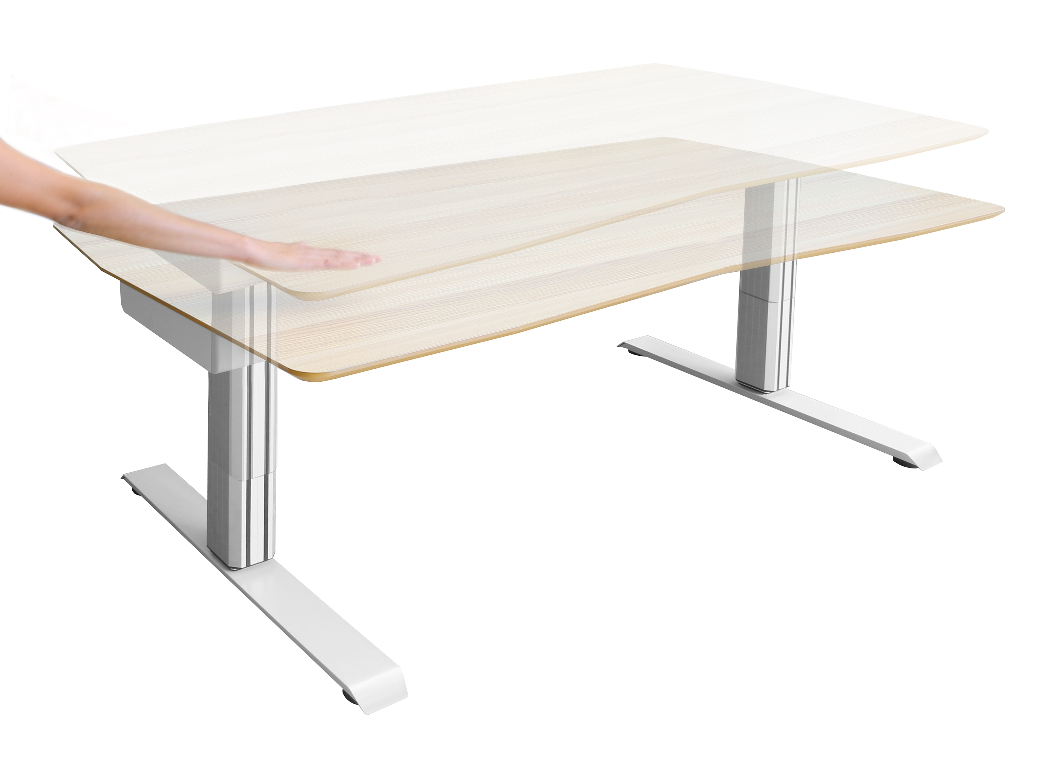


Model: OFFF42637
MSRP: $899.99
SMARTLIFT™ Electric Sit-Stand Desk
Specifications
Ultrasonic proximity sensor controller
Amazon Alexa® compatibility
Motors operate under 55 dB when in use
Two section telescoping frame
Rectangular desk top with chamfered edges
Top Material: MDF with melamine finish
Top Area: 60" W x 30“ D
Adjustment Range: 28.3" to 47.2" H
Adjustment Rate: 1.18" per second
Overall Size: 60" W x 30“ D x (28.2“ to 47.2") H
Weight Capacity: 176 lbs
Touch-Free Control – Gesture to the height you want and watch the SMARTLIFT™ rise (or fall) to the occasion. The sensor “sees” solid objects that pass above and below it.
Voice Commands – Connect with the Amazon Echo® or Echo Dot®. Lift or lower with a few words. (Compatibility with other smart devices forthcoming)
Sustainable Materials – The frame is built completely of recyclable materials. Steel makes up the base and the two telescoping legs are built of aluminum.
Scratch-Resistant – Top finished in super-hard melamine for protection from abrasive dangers and the hazards of daily life.

